Slide 1
Clean Air Vehicles vs. Air Pollution
A Data Analysis study
Scott McLaughlin

Slide 2
Hypothesis
States that show higher adoption of Electric, Plug-In Hybrid, and Hybrid vehicles will show a measurable improvement in air pollution from roadway sources.

Slide 3
Data sets
Pollution data:
EPA National Emissions Inventory (NEI)
Years available:
2008, 2011, 2014, 2017, 2020
Clean Air Vehicle (CAV) adoption rates:
US Dept. of Energy Alternative Fuels Data Center (AFDC)
Years available:
2016 - 2021

Slide 4
2020 data & COVID
Pollution emissions in 2020 were very likely impacted by the COVID pandemic, and the ensuing stay-at-home orders. This limits the conclusions that can be drawn based on 2020’s data.
NEI data is published every three years, with the next publication expected at the end of 2023. This data, were it available for the current analysis, would greatly increase the confidence of any conclusions.

Slide 5
Ten states with the highest and lowest % of CAV registrations selected for analysis.
CA, while showing the highest adoption, does not collect or report data in a way that is consistent with other states. CA was therefore excluded from the analysis.
High CAV % of Registrations*
State | 2016 | 2017 | 2018 | 2019 | 2020 | 2021
California | 4.0 | 4.4 | 4.8 | 5.3 | 5.6 | 6.4
Washington | 2.7 | 3.0 | 3.4 | 3.8 | 4.2 | 4.9
Oregon | 2.7 | 2.9 | 3.2 | 3.5 | 3.9 | 4.6
Hawaii | 2.7 | 2.9 | 3.1 | 3.5 | 3.8 | 4.4
Vermont | 2.2 | 2.4 | 2.6 | 2.8 | 3.1 | 3.8
Massachusetts | 2.1 | 2.2 | 2.5 | 2.7 | 3.0 | 3.6
Maryland | 2.1 | 2.2 | 2.4 | 2.6 | 2.9 | 3.5
Colorado | 1.7 | 1.9 | 2.1 | 2.3 | 2.6 | 3.2
Nevada | 1.6 | 1.8 | 2.0 | 2.2 | 2.4 | 3.0
Virginia | 1.8 | 2.0 | 2.1 | 2.3 | 2.5 | 2.9
Arizona | 1.8 | 1.9 | 2.1 | 2.2 | 2.5 | 3.0
Low CAV % of Registrations
State | 2016 | 2017 | 2018 | 2019 | 2020 | 2021
Mississippi | 0.49 | 0.52 | 0.56 | 0.59 | 0.64 | 0.78
North Dakota | 0.47 | 0.53 | 0.53 | 0.58 | 0.64 | 0.81
Louisiana | 0.50 | 0.53 | 0.55 | 0.59 | 0.65 | 0.82
Wyoming | 0.68 | 0.70 | 0.75 | 0.75 | 0.86 | 1.05
Alabama | 0.70 | 0.74 | 0.78 | 0.82 | 0.89 | 1.07
South Dakota | 0.66 | 0.71 | 0.76 | 0.82 | 0.89 | 1.11
West Virginia | 0.64 | 0.68 | 0.72 | 0.80 | 0.90 | 1.12
Arkansas | 0.78 | 0.81 | 0.84 | 0.89 | 0.94 | 1.13
Oklahoma | 0.64 | 0.69 | 0.81 | 0.82 | 0.90 | 1.29
Kentucky | 0.85 | 0.92 | 0.99 | 1.06 | 1.17 | 1.39
* CA excluded from analysis

Slide 6
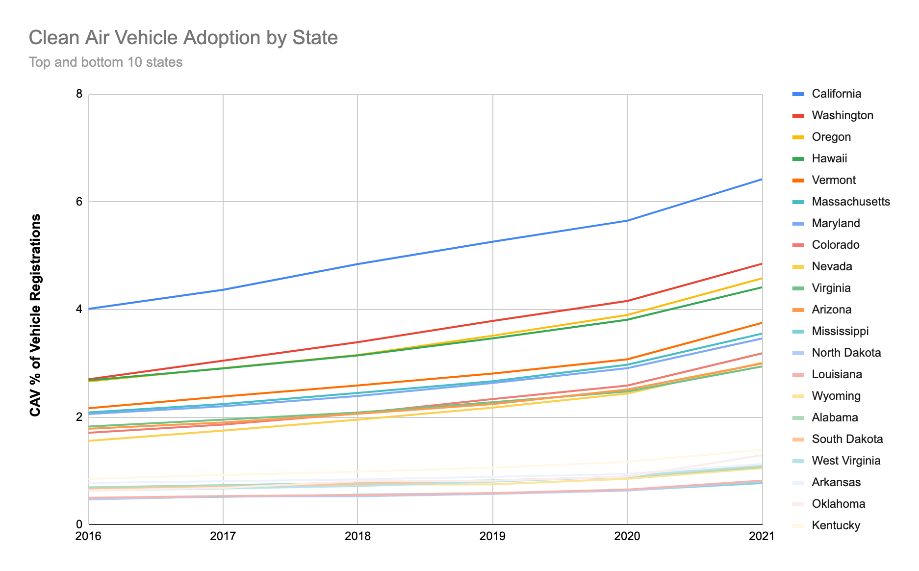

Slide 7
Pollutants
Four greenhouse gasses and nine health pollutants
Greenhouse Gasses
Carbon Dioxide
Carbon Monoxide
Methane
Nitrous Oxide
Health Pollutants
Chromium 6
Manganese
Mercury
Nickel
Nitrogen Oxides
Sulfur Dioxide
Volatile Organic Compounds
Particulate Matter (health)
Large: less than 10 microns (um)
Fine: less than 2.5 microns (um)
Health Impacts
Several studies have shown a clear impact of roadway pollution on health. Resources can be found from the American Lung Association, among others.

Slide 8
Units of NEI emissions data
“NEI emissions values represent total annual emissions for the inventory reporting year. Criteria air pollutants and precursors (CAPs) are reported in short tons per year, and hazardous air pollutants (HAPs) are reported in lbs per year.”
In the following slides, county level data has been summed for each state, then plotted with a trend line. Averages are also plotted on separate slides. Individual states are not called out to preserve readability.

Slide 9
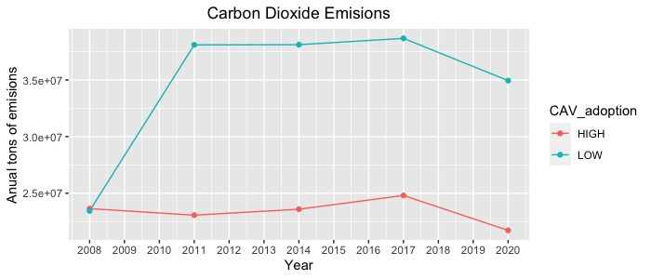
Greenhouse Gasses
Greenhouse Gas pollution - averages

Slide 10
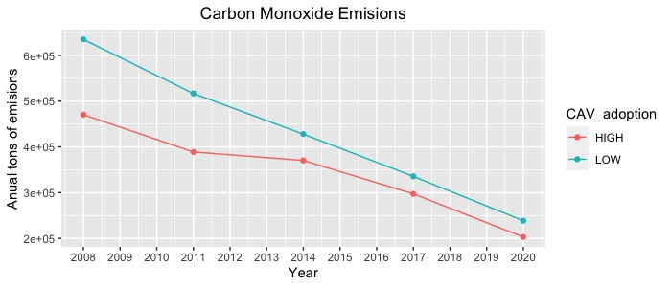
Greenhouse Gasses
Greenhouse Gas pollution - averages

Slide 11
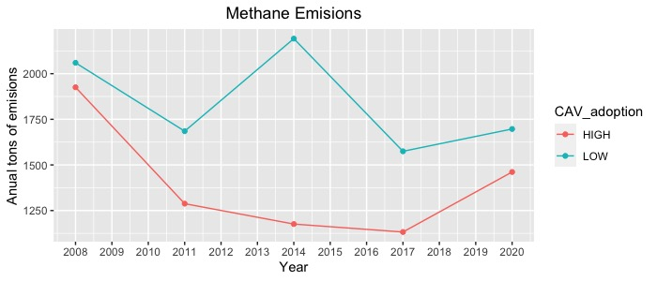
Greenhouse Gasses
Greenhouse Gas pollution - averages

Slide 12
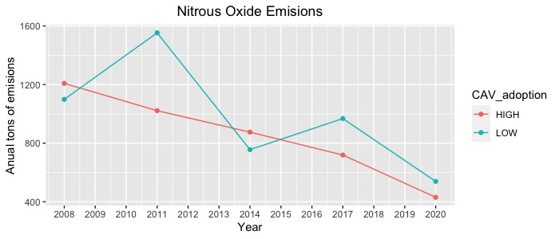
Greenhouse Gasses
Greenhouse Gas pollution - averages

Slide 13
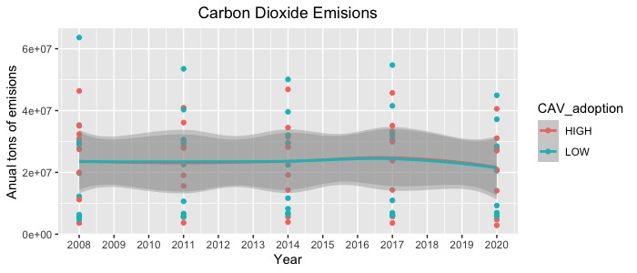
Greenhouse Gasses
Greenhouse Gas pollution - points
Trend-lines are identical but data spread too wide for conclusions

Slide 14
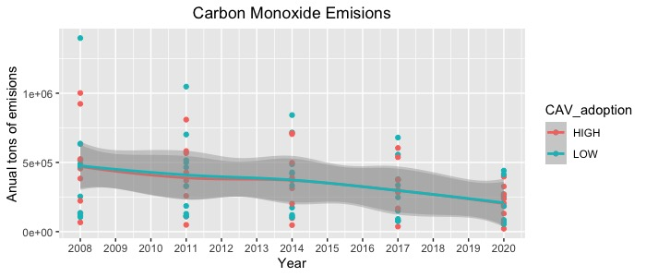
Greenhouse Gasses
Greenhouse Gas pollution - points
Trend-lines are identical but data spread too wide for conclusions

Slide 15
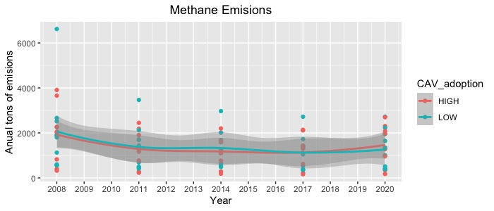
Greenhouse Gasses
Greenhouse Gas pollution - points
Trend-lines are nearly identical with data spread too wide for conclusions

Slide 16
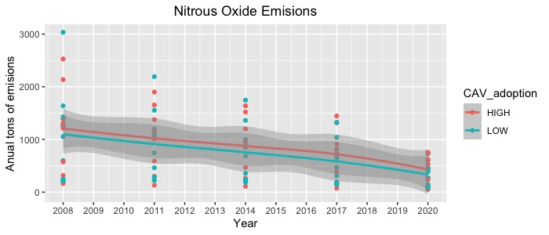
Greenhouse Gasses
Greenhouse Gas pollution - points
Trend-lines are parallel but data spread too wide for conclusions

Slide 17
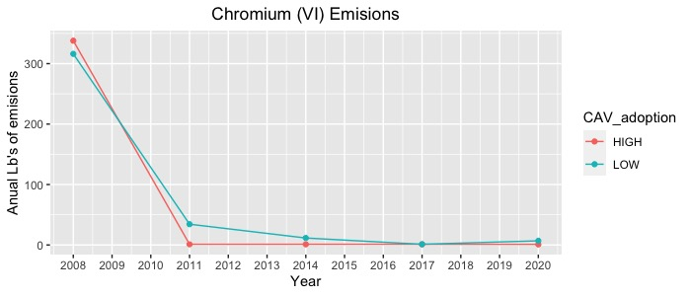
Health hazards
Health Pollutants - Averages

Slide 18
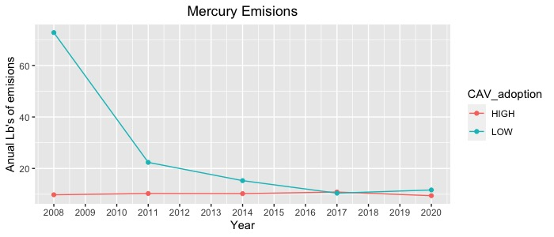
Health hazards
Health Pollutants - Averages

Slide 19
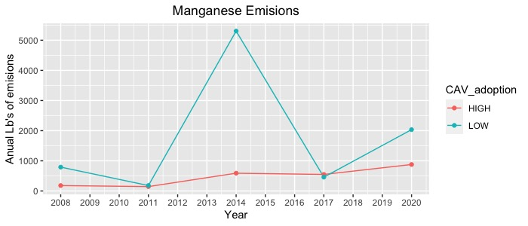
Health hazards
Health Pollutants - Averages

Slide 20
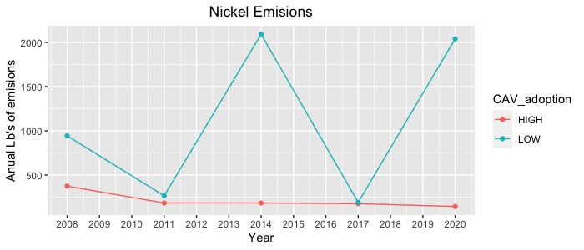
Health hazards
Health Pollutants - Averages

Slide 21
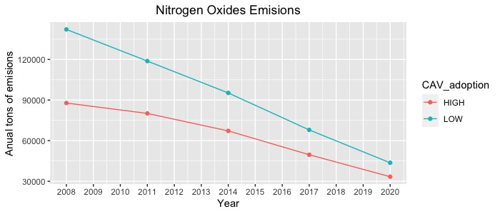
Health hazards
Health Pollutants - Averages

Slide 22
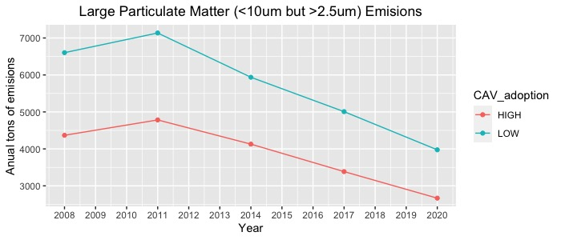
Health hazards
Health Pollutants - Averages

Slide 23
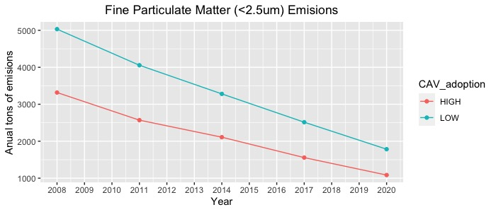
Health hazards
Health Pollutants - Averages

Slide 24
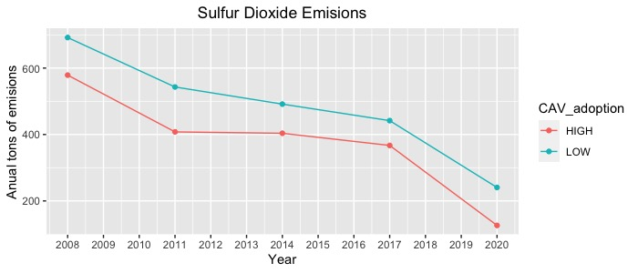
Health hazards
Health Pollutants - Averages

Slide 25
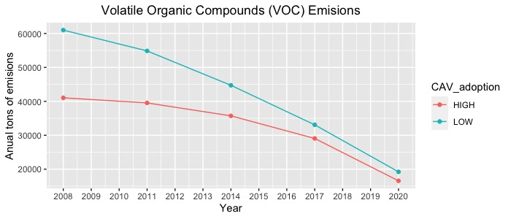
Health hazards
Health Pollutants - Averages

Slide 26
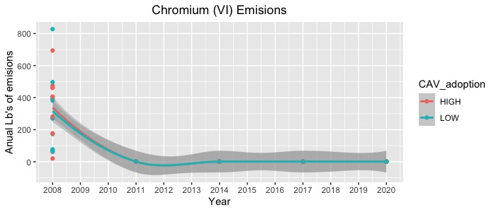
Health hazards
Health Pollutants
Trend-lines are identical and data past 2008 very tightly spaced

Slide 27
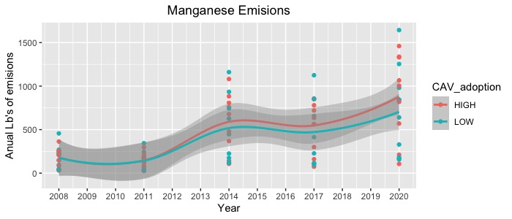
Health hazards
Health Pollutants
Trends slightly counter to expectations
data spread too wide for conclusions
Progressively worse over time

Slide 28
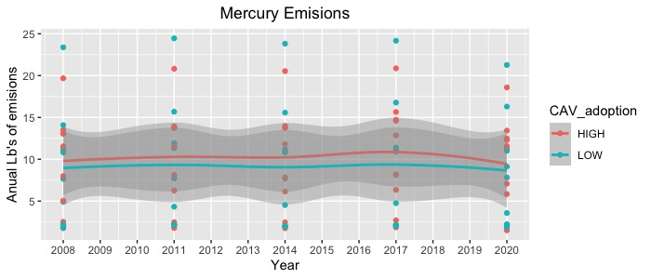
Health hazards
Health Pollutants
Trend-lines parallel with counter-intuitive positioning
data spread too wide for conclusions

Slide 29
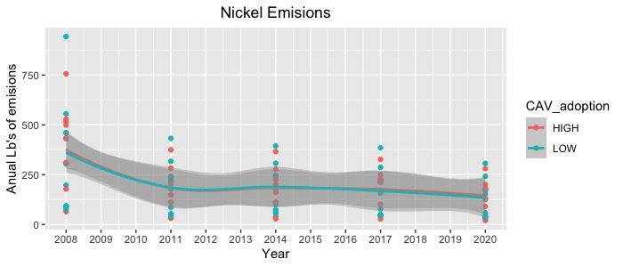
Health hazards
Health Pollutants
Trend-lines are identical

Slide 30
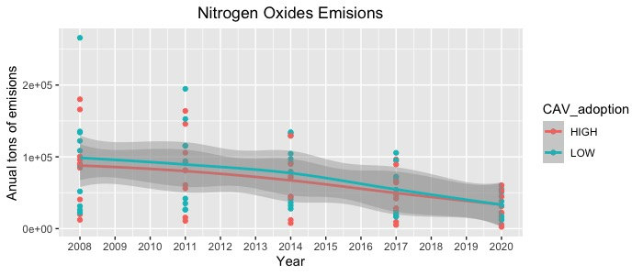
Health hazards
Health Pollutants
Trend-lines are nearly identical

Slide 31
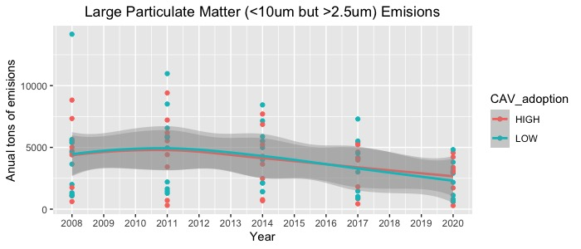
Health hazards
Health Pollutants
Trend-lines are identical

Slide 32
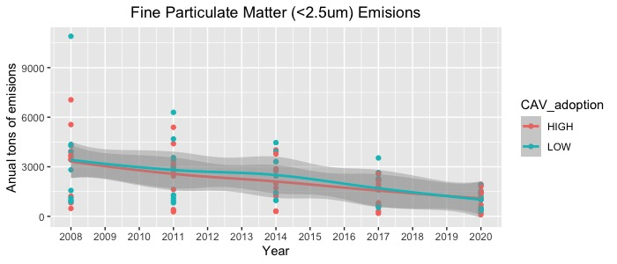
Health hazards
Health Pollutants
Trend-lines are identical

Slide 33
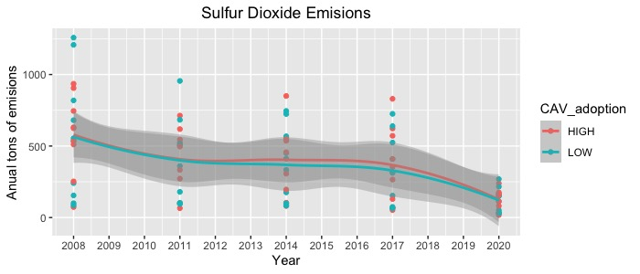
Health hazards
Health Pollutants
Trend-lines are nearly identical

Slide 34
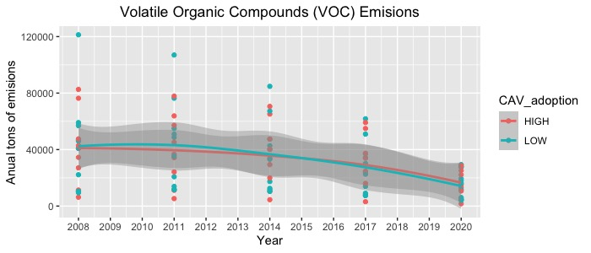
Health hazards
Health Pollutants
Trend-lines are identical

Slide 35
Conclusions
With only 4% adoption of CAV’s by 2020, there was not yet enough of a reduction in roadside pollution to be noticeable when comparing states with high vs. low adoption of Electric, Plug-in Hybrid, and Hybrid vehicles.
On the bright side, most pollutants analyzed here showed improvements, primarily in early years. Due to the similarity in most of the data across states, it is likely due to nationwide changes as opposed to those of individual states. One speculation is federal laws affecting the American fleet over time. Another, the natural phasing out of older vehicles with lower gas mileage.

Slide 36
The Future
2021 showed increase in clean air vehicle registrations, in both sets of states discussed. While information on 2022 and 2023 are not yet available, indications from other sources show increased sales of EV’s, PHEV’s, and Hybrids.
California, the most populous state in the union, recently announced the phasing out of gasoline cars by 2035. Other states are considering similar legislation. Even more states are incentivizing zero emission vehicles.
The 2023 NEI data set will be very interesting to review when it is available. Perhaps we will then be able to see the beginning of a separation in data for states that have more low and zero emission vehicles.

Slide 37
Sources
U.S. EPA National Emissions Inventory (NEI)
U.S. Dept. of Energy Alternative Fuels Data Center
American Lung Association
CA Phasing out Gasoline Cars - CNN
Other States following CA’s lead - Bloomberg

